Slide 1
Integration of Quality Assurance into Higher Institutions to Promote Academic Excellence in Nigeria
Adaka T. Ahon, PhD, FCILED, AFAAN
Professor of Special Needs Education,
Director, Centre for Disability Studies,
Federal University of Lafia
adaterfa@gmail.com
+2348058430226
A One Day International Workshop on Quality Control and Assurance in Higher Education Jointly Organized by 21st Century Open University and Global Interfaith University at Google Meet on September 13, 2025.

Slide 2
Introduction
Nigeria’s higher education system is in crisis, with declining quality and universities ranking far below their global and African counterparts.
Weak quality assurance has severely undermined academic performance.
Without urgent reforms, the nation risks producing graduates with certificates but lacking the competence for national development and global competitiveness.

Slide 3
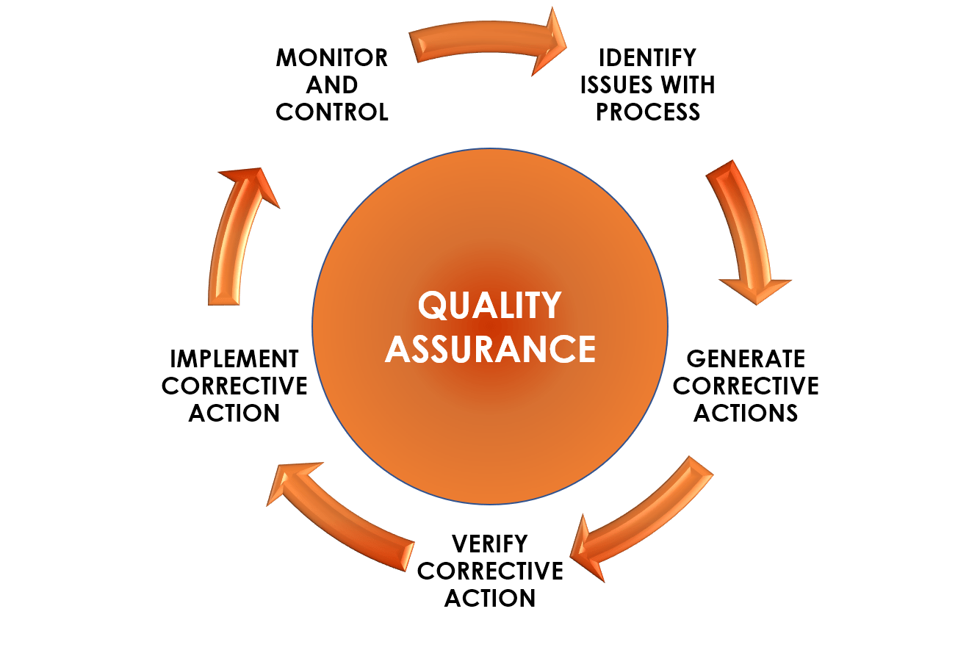
Quality Assurance
Quality Assurance (QA) is a management technique involving planned and systematic actions to ensure that educational delivery, teaching, research and facilities meet the right standards and provide students with the best possible learning experience.

Slide 4
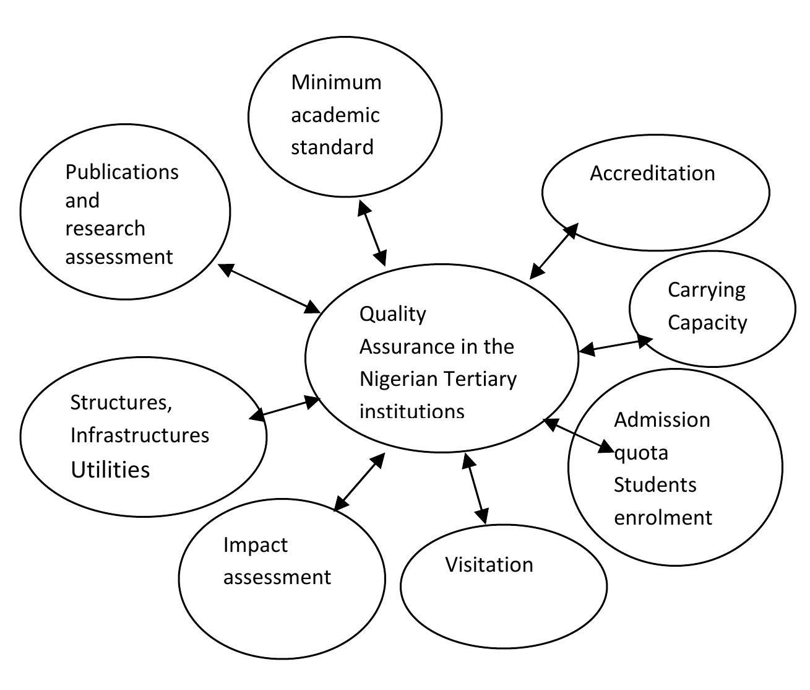
Shared Responsibilities of Universities and NUC in Ensuring Quality Assurance
Quality assurance drivers in Nigerian tertiary institutions adapted from Adedipe (2007)

Slide 5
Components of Quality Assurance in Higher Education
Curriculum Design and Review – Ensures curricula are updated, relevant and aligned with labor market demands. Regular reviews help produce employable graduates with globally competitive skills.
Teaching and Learning Processes – Focuses on lecturer competence, instructional delivery, and classroom interactions. It promotes student-centered learning and modern teaching methods.
Assessment and Evaluation – Guarantees fair, transparent, and comprehensive measurement of student learning. Continuous assessment complements final exams for a holistic evaluation.

Slide 6
Components….(cont’d)
Academic Staff Development – Supports training, workshops, and research opportunities for lecturers. This builds competence in teaching, research, and technology use.
Research and Innovation – Encourages quality research that addresses societal needs and promotes development. Institutions benefit from grants, publications, and industry collaborations.
Student Support Services – Provides counseling, health care, career guidance, and financial aid. These services enhance student well-being and reduce dropout rates.

Slide 7
Components….(cont’d)
Infrastructure and Learning Resources – Involves adequate classrooms, labs, libraries, and ICT facilities. Proper infrastructure improves learning and innovation.
· Governance and Administration – Emphasizes transparency, accountability, and effective leadership. Strong governance ensures institutional credibility and partnerships.
· External Accreditation and Benchmarking – Independent bodies assess programs against national and global standards. Accreditation boosts trust, mobility, and competitiveness.

Slide 8
Role of Quality Assurance in Improving Academic Performance
Enhances Teaching and Learning Quality
Ensures Curriculum Relevance
Improves Student Satisfaction and Learning Experience

Slide 9
Role….(cont’d)
Positively Correlates with Academic Outcomes
Explains Significant Variance in Student Performance
Facilitates Accountability and Continuous Improvement

Slide 10
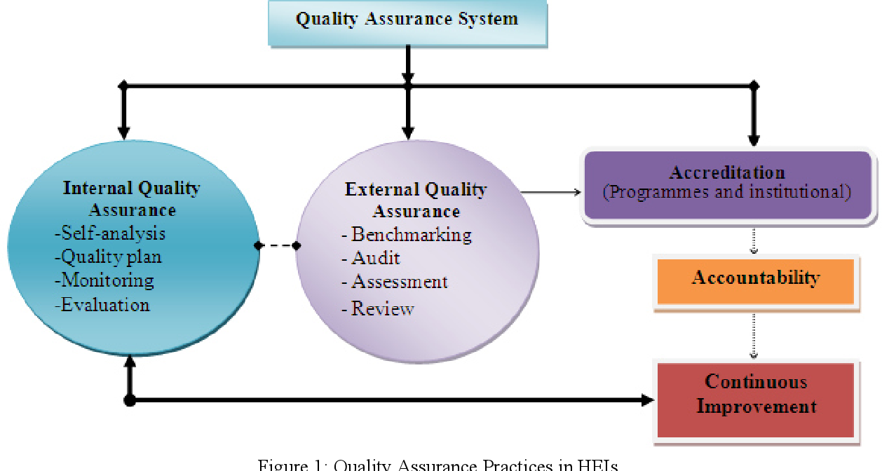
Quality Assurance Practices in Higher Institutions

Slide 11

Challenges of Implementing Quality Assurance Mechanism
Inadequate Funding
Resistance to Change
Insufficient Skilled Personnel
Weak Institutional Capacity
External Influences and Political Interference
Overemphasis on Compliance Rather than Improvement

Slide 12
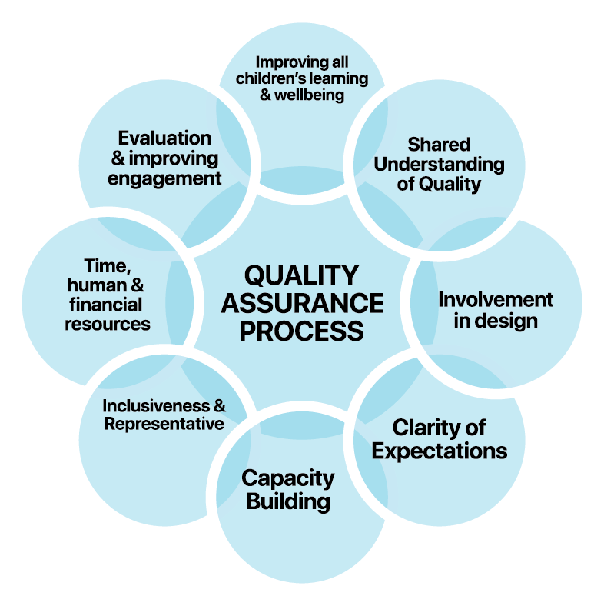
Ways of Integrating Quality Assurance in Tertiary Institution

Slide 13
Ways….(cont’d)
To simply the ways of integrating quality assurance in tertiary institutions, the following are required:
The formulation of a defined mission and institutional objectives
Creating robust internal quality control systems
Ensuring external quality assurance via audits and accreditation
Regular curriculum design and review
Improving teaching and learning processes
Increasing institutional autonomy, leadership and governance

Slide 14
Conclusion
Nigeria’s higher institutions urgently need strong quality assurance systems to address poor performance and global ranking. Integrating quality assurance through curriculum review, effective teaching, and sound governance will raise academic standards. Prioritizing quality assurance will improve learning, research, and institutional reputation.

Slide 15

THANK YOU FOR LISTENING!

